Slide 1
Preserving Our Community
A Presentation to the Key West Historical Architecture Review Committee
Notes:
Thank you very much for the opportunity to present before you tonight. I’d like to introduce some colleagues from FIRM who are here tonight:
Chic Wagner, E.D.
Annalise Mannix, former E.D. and Project Manager for our Windstorm Risk Analysis
Joyce Chilton, Aide to the Board
Cindy DeRocher, FIRM Founder and Vice President of the Board
Carol Schreck, FIRM Secretary
Lee Cummings, Board Member
Barry Philipson, Board Member

Slide 2
Introduction: Who is FIRM?
Grassroots organization fighting for property insurance rates that are neither unreasonable, excessive, or unfairly discriminatory
Results of eight years of work on windstorm insurance
Saved Monroe County rate-payers an estimated $360 million+
Changed modeling standards
Addressed issues related to claims processing, payment options, statewide building codes
Notes:
I hope you are all aware of who FIRM is. We are a
grassroots organization,
entirely funded by donations,
that has been fighting for fair windstorm insurance rates since February of 2006.
We have had quite a bit of success in
controlling the rate of escalating windstorm insurance premiums
Improving models used to forecast risk
and have saved the County millions of dollars.
As you may know, we are not focussing on flood insurance as well – a federal issue, maybe more vexing than working with Citizens.

Slide 3
Introduction (continued): Who is HARC?
Historic Architecture Review Commission
Seven-member board
Charged with the preservation and conservation of the character, integrity and appearance of the historic preservation districts as well as for buildings individually listed in the National Register of Historic Places and buildings listed as contributing in the Historic Structure Survey of the city.
Notes:
HARC is the
Seven-member appointed board
Charged with preservation and conservation of
Character
Integrity and
Appearance of
Building on the National Register of Historic Places
Buildings listed as contributing in the Historic Structure Survey of Key West

Slide 4
Introduction (continued): Common Ground
HARC charged with preserving historical structures and their character
FIRM interested in preserving property, protecting life and maintaining the character of the Keys
Both organizations are interested in preservation and protection
Notes:
We have common ground.
Both of our organizations are interested in preserving our properties, and our the character of our community.

Slide 5
Section 1: Energy Conservation
The Florida Energy Efficiency and Conservation Act requires that homeowners be permitted to utilize energy efficient components in their homes.
“Green” initiatives endorsed by both the City of Key West and Monroe County encourage the use of energy-efficient materials.
Notes:
Let’s begin by talking about energy.
State regulations require that homeowners be allowed to utilize energy-efficient components in their homes.
In fact, the Florida Energy Efficiency and Conservation Act outright pre-empts any local ordinance that frustrates that purpose...(Cushman v. City of Key West...white roof case, Judge Audlin)
Both the City and the County encourage the use of energy-efficient materials

Slide 6
Section 1 (continued): Energy Conservation
The Secretary of the Interior’s Standards for Rehabilitation recommend “Installing compatible and energy-efficient replacement windows that match the appearance, size, design, proportion and profile of the existing historic windows and that are also durable, repairable and recyclable, when existing windows are too deteriorated to repair.”
Notes:
The Secretary of the Interior’s Standards for Rehabilitation state that
When existing windows cannot be repaired, they should be replaced by windows that
Essentially mimic the aesthetics of the historic windows, but are
Durable
Repairable
Recycleable

Slide 7
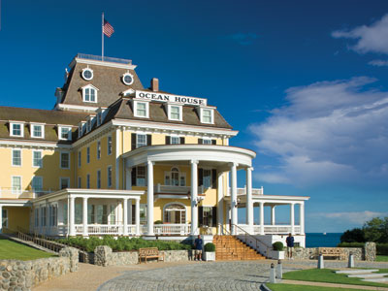
Section 1 (continued): Energy Conservation
Today, options exist to craft energy-efficient impact windows of wood, steel and synthetic materials that replicate the appearance of historic windows.
Notes:
There are plenty of options today for non-wood, impact-resistant windows that can replicate the
Appearance
Size
Design
Proportion of the original historic window

Slide 8
Section 1 (continued): Energy Conservation
Harmonizing regulations relating to energy efficiency with HARC regulations especially as it pertains to windows and shutters would not be difficult.
Other historic jurisdictions have successfully accomplished this:
Washington, DC
Boston, MA (9 districts, all with varying standards)
Notes:
It is possible to harmonize HARC regulations regarding energy-efficiency and home-hardening with historic preservation.
Other historic jurisdictions have done that.
I would like to note, however, that neither Boston, nor Washington, nor St. Petersburg are quite like Key West. They do not share our same meteorological history nor our economic profile.

Slide 9
Section 2: Preserving Property
Impact windows are in place year-round. The historic home is protected regardless of a homeowner’s ability or availability to put up shutters, regardless of how quickly a storm develops.
Preventing wind from entering a home and causing the uplift that can remove a rooftop is the ultimate in preservation.
Notes:
Fundamentally, we believe that impact windows crafted to meet the appearance, size, design and profile of historic windows do a better job of preserving our historic homes.
Impact windows are always deployed.
They prevent an opening from being breached, from allowing uplift that can blow off a rooftop.

Slide 10
Section 2 (continued): Preserving Property
Most models used to set rates for windstorm insurance give impact glass the strongest rating, equivalent to or greater than Class A engineered shutters (aluminum corrugated shutters, roll-down shutters, accordian shutters).
FCHLPM Form V-2 Mitigation Measures (Excerpted Measures indicated on FCHLPM Forms) |  |  | Modeled Mitigation Benefits
Individual Mitigation Measures |  |  | Modeler
Reference structure - 135 MPH Frame Structure |  |  | AIR | ARA | Equecat* | FPM | RMS
Opening Protection | Shutters | Plywood | 9.70% | 15% | 7.20% | 3% | 10.80%
 |  | Steel | 9.70% | 8% | 7.20% | 5% | 15.80%
 |  | Engineered "A" | 16.40% | 29% | 11.70% | 7% | 20.70%
Door and Skylight Covers |  |  | 4.80% | 0% | 10.40% | 1% | 20.70%
Window, door & skylight strength | Windows | Laminated | 4.90% | 0% | 7.20% | 7% | 0%
 |  | Impact glass | 16.40% | 29% | 7.20% | 9% | 20.70%
*Equecat is not used for insurance modeling, but primarily for reinsurance modeling. Source: Florida Commission on Hurricane Loss Projection Methodology Submissions 2011 Model Year Compiled November 11, 2012 by Annalise Mannix, P.E.
Notes:
Most risk modelers agree that impact windows do the best job of protecting a home from wind damage.
They provide as much protection, noted by insurance modelers as mitigation benefit, as do accordian, roll-down or aluminum shutters.
NOTES:
Equecat is primarily used by reinsurers – the folks who insure the insurers.
The FPM is the Florida Public Model. Their model focusses on how many nails are in a roof.

Slide 11
Section 2 (continued): Preserving Property
Are Shutters Equivalent to Wind Resistant Windows?
Yes, shutters protect openings about as well as impact windows – but only if you are home to close them. If you can't get back here while a storm is barreling down (say you are on a business trip or visiting Mom) or if you can't get to the windows with a ladder you are at a loss. Envision the 80-year old or a pregnant mom, or an unstable 40-year old with a bad knee and no hand-eye coordination installing shutters alone - virtually impossible. How about the physically or mentally disabled? And where do you store that 30-40 foot ladder for these tall homes?
Notes:
Are shutters as good as impact windows? Yes – BUT ONLY IF THEY ARE PUT UP.

Slide 12
Section 3: Undue Hardship
Historic architecture review committees have a responsibility to mitigate against “undue economic hardship for the property owner.”
HARC’s insistence on wood-frame windows in the historic district causes hardship in several ways.
Notes:
Now we’d like to talk about economic hardship.
Historic architecture review committees are charged with preventing undue economic hardship.
Current HARC guidelines regarding window replacement cause economic hardship in several ways.

Slide 13
Section 3 (continued): Undue Hardship
Windows approved by HARC and wood-clad windows (likely approved by HARC) are more expensive than other impact windows. These estimates are for a typical 3’ x 5’ single pane window.
Type of Window | Approx. Cost
HARC-approved single pane wood-frame window | $600
Synthetic-clad single pane impact window | $400-$450
Wood-clad single pane impact window | $1,000
Estimate from Lane Thrasher at Island Doors
Notes:
First, approved wood-frame windows are 25% to 120% more expensive than synthetic-clad impact windows. For a house with 20 3’ x 5’ windows, using HARC approved windows would add at least $3,000 to the job.

Slide 14
Section 3 (continued): Undue Hardship
The use of shutters on top of replacement windows causes the homeowner to pay twice for protection. The homeowner pays once for the new window, and again for shutters to be installed ($250). The initial cost is excessive, and has greater life cycle cost given wood’s potential to rot and requirement to be repainted.
Notes:
To protect those 20 windows, the homeowner would need to spend another $5,000 for shutter installation. They have now paid almost twice as much for new windows as someone who uses synthetic-clad impact windows.
($600 x 20 = $12,000) + ($250 x 20 = $5,000) = $17,000
$450 x 20 = $9,000

Slide 15
Section 3 (continued): Undue Hardship
Wood shutters, approved by HARC, receive no mitigation credits from Citizens Property Insurance. Windstorm insurance is more costly to homeowners who adhere to HARC guidelines.
Type of Window | Cost
Base Premium without credit for window protection | $20,226
Base premium with credit for window protection | $12,337
Estimate for a $300,000 frame house built in 1928, provided by Southernmost Insurance Agency
Notes:
Now, if the homeowner who has followed HARC guidelines uses historically accurate wood shutters – which receive NO insurance mitigation credits – will pay about $8,000 more per year for windstorm insurance alone.

Slide 16
Section 3 (continued): Undue Hardship
It is somewhat naïve to believe that a wood window installed today is equivalent to a wood window installed a century ago. The former is from farmed new growth wood and likely less durable than the former, crafted from old growth wood.
The maintenance and increased frequency of replacing wood-frame windows compared to impact windows is an additional economic hardship.
Notes:
These are not one-time costs.
Today’s wood windows are simply not constructed of the same quality wood that yesterday’s windows were.
Wood-frame windows require frequent maintenance, upkeep and replacement. They do not fit the Secretary of the Interior’s Standards for rehabilitation because they are not
Durable
Repairable
Recycleable.

Slide 17
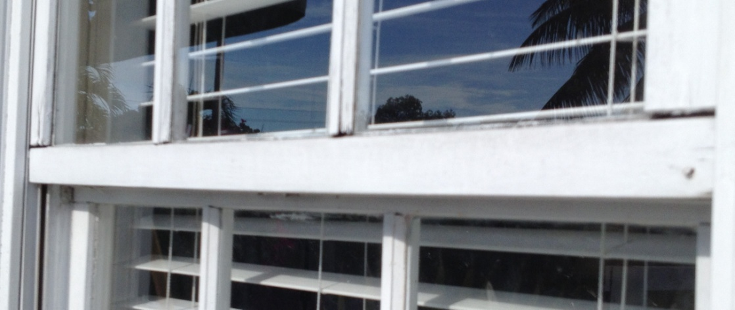
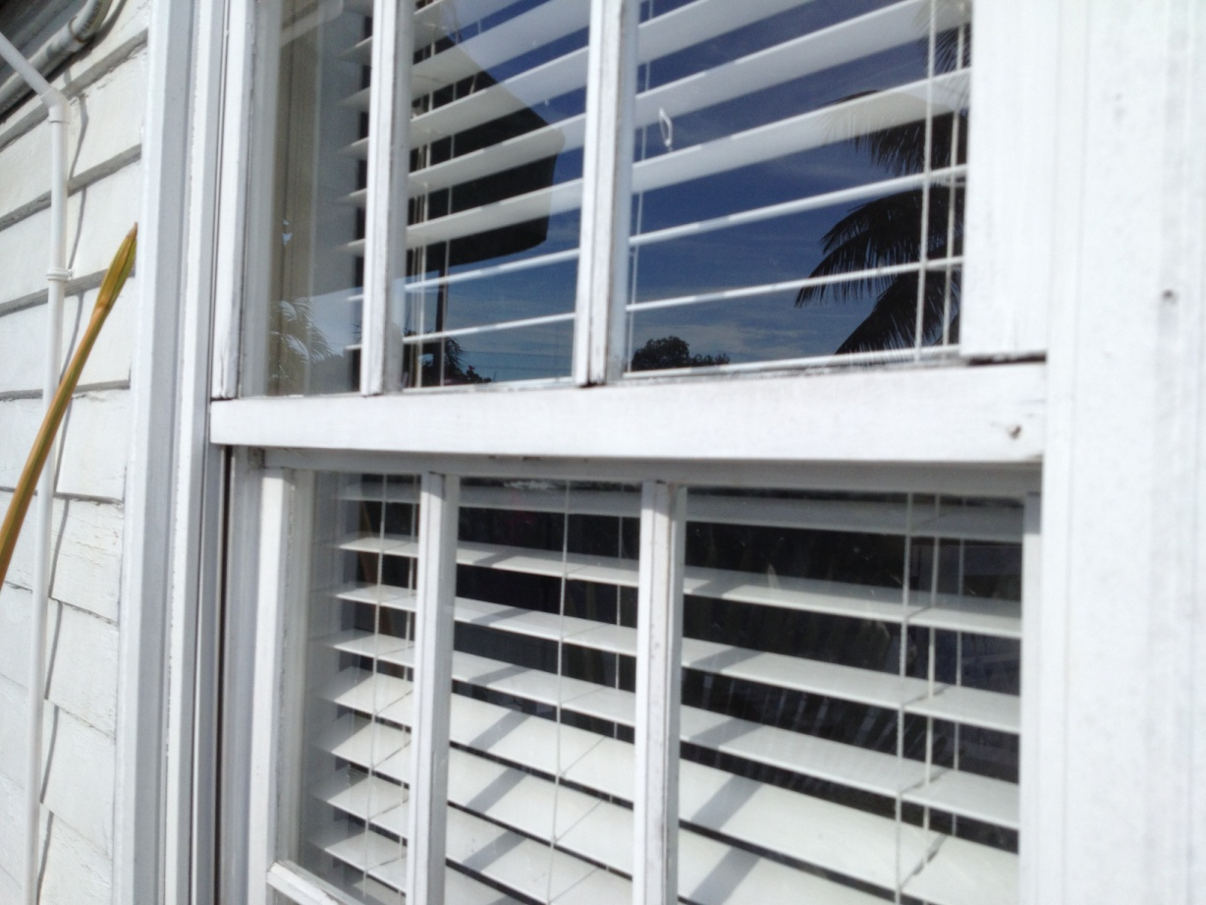
Section 3 (continued): Undue Hardship
Example: Wood-frame window on White Street installed in 1996
Sash has separated from the window
Notes:
Here’s an example of a wood-frame window that was installed on White Street about 17 years ago. It needs to be replaced again.

Slide 18
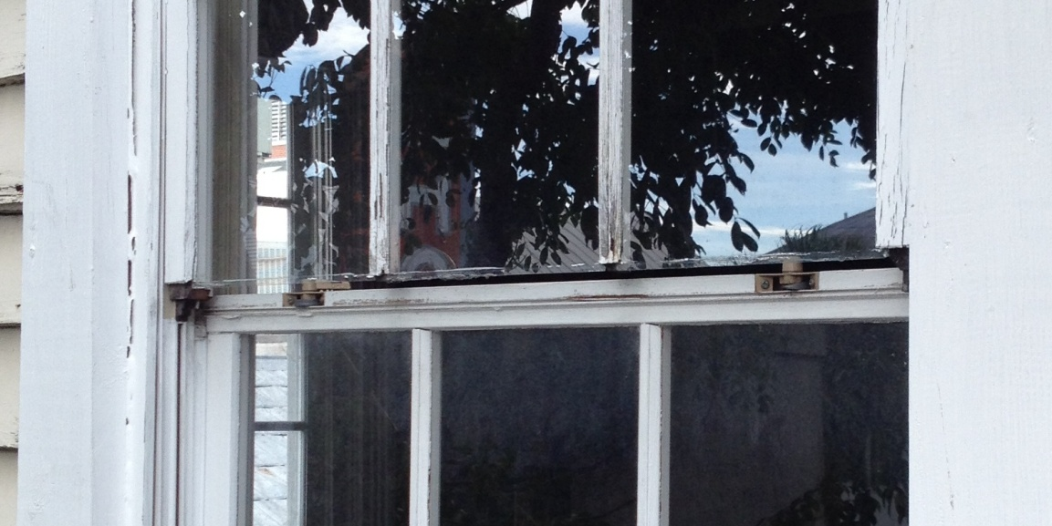
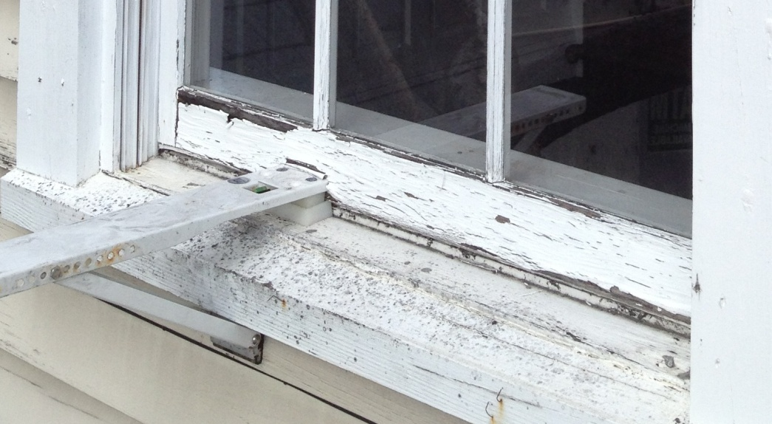
Section 3 (continued): Undue Hardship
Example: Wood-frame window on Duval Street installed in 2005
Sash separated from window, glass ready to slip from window
Wood completely rotted
Notes:
Here’s another example of a wood-frame window installed in a home on Duval Street less than a decade ago. Lots of wood rot.

Slide 19
Section 4: Life Safety
Two means of egress from bedrooms are required by code to allow for adequate exit in the case of an emergency.
When shutters are in place on every opening to a home except one door, should that door be blocked for any reason, fire rescue may have no access to the home and its occupants.
Sometimes homeowners leave shutters up on many windows for the entire storm season to avoid the difficult task of hanging them over and over.
Notes:
Let’s talk a bit about life safety. Life safety codes require two means of egress from any bedroom.
If all windows have been shuttered and the only remaining means of egress is blocked for some reason, occupants have no means of escape.
This could be a life-threatening situation.
Or it could be a major inconvenience. When Annalise’s house was shuttered for Wilma, she could not get out after the storm because the flood waters had made her front door swell. The fire department had to knock down her front door with an ax.
Some homeowners leave shutters up throughout hurricane season. How will they get out if their remaining door is blocked?

Slide 20
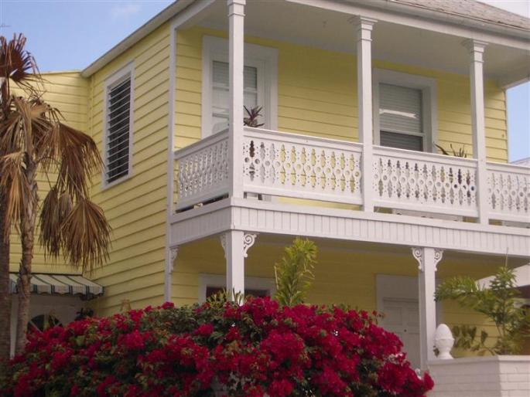
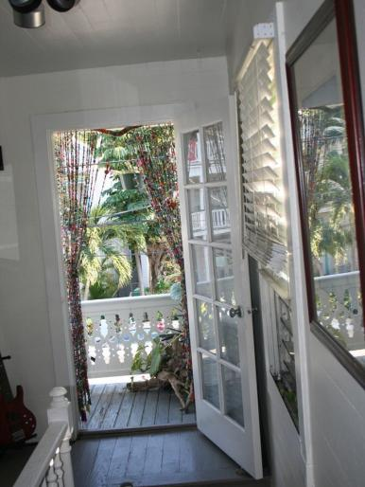
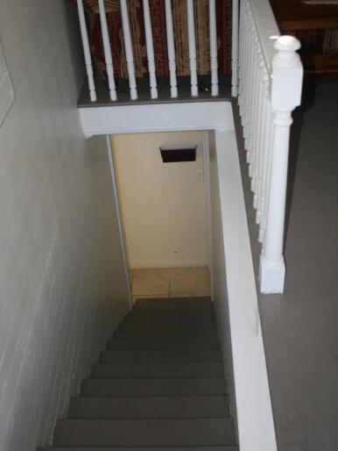
Section 4 (continued): Life Safety
This is a legal duplex in Old Town Key West. Imagine aluminum shutters on all the doors and windows in preparation for a Cat 1 hurricane.
This is the upstairs porch door. Imagine it closed and shuttered from the outside.
This is the only other exit, an interior staircase. Imagine there is a fire on the first floor. How would you get out?
Notes:
Here’s an example.

Slide 21
Section 4 (continued): Life Safety
For any government, issues related to life safety should be paramount. Adherence to fire/safety codes must trump other considerations.
Notes:
It seems to me that it is not only prudent, but is the primary function of government to preserve life safety. This should trump all other considerations.

Slide 22
Section 5: Other Considerations
Through renovation, the same structure may have windows installed with both synthetic (new addition) and wood (original section of the house). Is that historic?
Many “snowbirds” own homes in Old Town Key West, and many leave aluminum shutters up all summer long. Is that historic?
Notes:
Just a few more points to bring up concerning consistency.
HARC already allows synthetic-clad impact windows both on non-contributing structures in the historic district, and on additions to contributing structures. And from the street, you often can’t tell the difference.
Some homeowners leave corrugated aluminum shutters in place all summer long. These completely obscure the historic appearance of our historic district.

Slide 23
Section 5 (continued): Other Considerations
Under Rule 8, Windows, page 30, HARC guidelines provide as follows: "The use of laminated impact resistant glass, wind resistant films, glass or plexiglass which does not alter the appearance of windows on the exterior is allowed. Materials and details should be selected so as to minimize visual impact on the historic structure.”(Emphasis added)
If this is the current standard, it should not be too much to take the next logical step concerning impact-resistant windows throughout the structure.
Notes:
HARC already allows the use of impact materials as long as the appearance of the historic structure is maintained.

Slide 24
Section 6: Recommendations
Amend HARC guidelines to allow homeowners the choice to install new, historically similar windows and doors so homeowners may benefit from energy efficient windows and storm opening protection.
Provide a sample list of acceptable impact vendors and products.
If desired, homeowners may still utilize wood-frame windows if they wish to preserve the authentic material.
Notes:
So what would FIRM recommend? In general,
Allowing windows that replicate the appearance, design, etc. of historic windows to be installed on contributing structures.
Providing homeowners with a sample list of acceptable products and vendors.
This does not mean that homeowners MUST use impact windows, just that they have a CHOICE of using original materials, or more energy-efficient and impact-resistant ones.

Slide 25
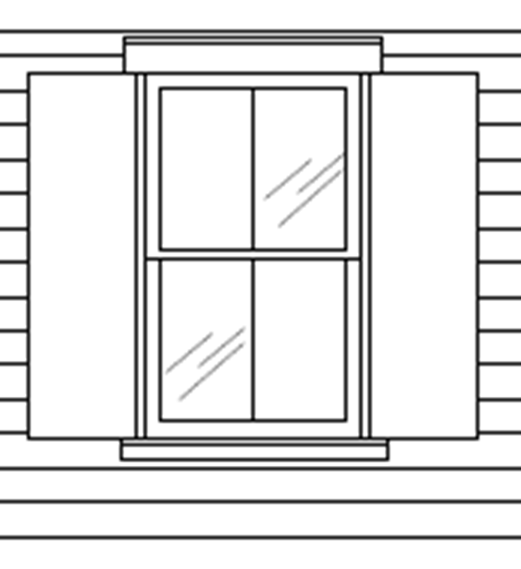
Section 6 (continued): Recommendations
Amend existing HARC regulations. Current language:
Replacement windows on CONTRIBUTING structures should be made to fit the original window opening without the use of blocking or infill. Such replacement windows, sills, muntins, sashes, surrounds and other window features should be of similar and compatible configuration, material, size, design, and placement as those of original windows.
Molding
Muntins
Sash
Meeting Rail
Notes:
So here is the current language in the HARC guidelines.

Slide 26
Section 6 (continued): Recommendations
Proposed new language regarding replacement windows.
Replacement windows on CONTRIBUTING structures should be made to fit the original window opening without the use of blocking or infill. Such replacement windows, sills, muntins, sashes, surrounds and other window features should be of similar and compatible configuration material, size, design, and placement as those of original windows.
ADD: The definition of similar with regard to muntins and sashes shall be the current standard for Florida Building Code Approved windows meeting required pressures.
Notes:
This is how we would suggest amending that language. Simply strike the word “material” and confirm that “similar” muntins and sashes must meet Florida Building Code standards.

Slide 27
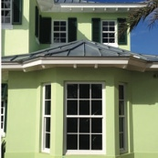
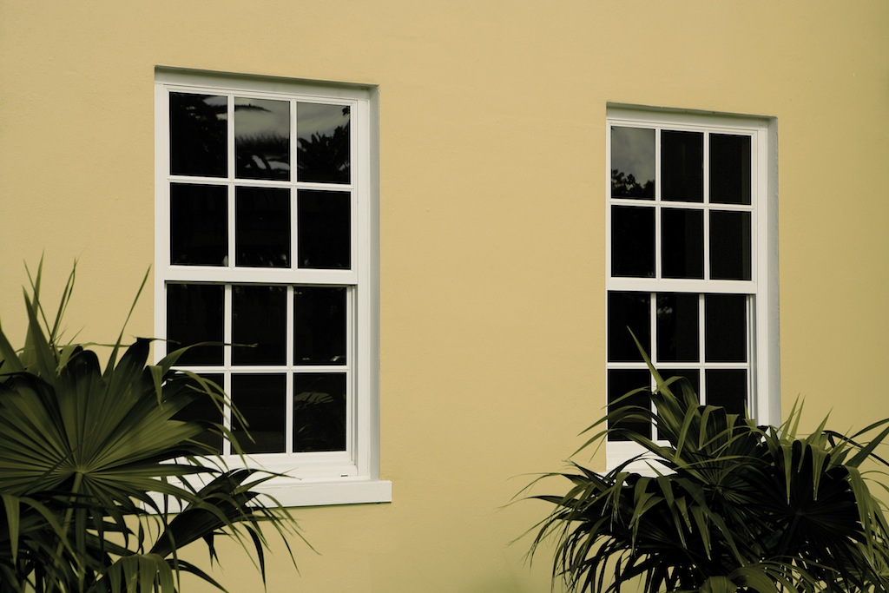
Section 6 (continued): Recommendations
New metal windows can meet all historic design criteria other than “material”.
Original opening size
Sill similar size
Muntins similar size
Sashes
Surrounds
Other window features
CGI Estate Collection
Notes:
And here is an example of windows crafted of metal that resemble wood-frame windows.

Slide 28
Section 6 (continued): Recommendations
Proposed new language regarding the definition of hardship.
The definition of economic hardship for an applicant should be amended as follows to match the City's Workforce Housing Ordinance. "An applicant for a rental dwelling unit shall mean a dwelling unit whose monthly rent, not including utilities, does not exceed 30 percent of that amount which represents 140 percent of the monthly median household income (adjusted for family size) for Monroe County. For an owner-occupied dwelling unit, affordable housing (middle income) shall mean a dwelling unit whose sales price shall not exceed six and one-half times the annual median household income (adjusted for family size) for Monroe County, in accordance with section 122-1472.”
Notes:
We would also suggest that HARC guidelines be consistent with City guidelines in terms of the definition of “economic hardship.” That’s why we suggest adding this language.
NOTE: Current median HH income is $63,000, so that would mean a home over $409,500 would qualify as one where “economic hardship” would be relevant.

Slide 29
CONCLUSION
Key West is unique, subject to forces of weather and economics that no other historic district in the nation faces.
Key West has a history of resilience and adaptation, including
Changes in our economic drivers (sponging, salvaging, cigar-making, the military and now tourism and second home-ownership)
Changes in how we build
Tin roofs emerged after the fire of 1886
Jalousie windows emerged as Key West expanded eastward
Will these be “protected” as HARC’s jurisdiction expands to include homes built after 1960?
Notes:
While it’s informative to look at other historic districts and their regulations, we should note that Key West is unique.
Unique weather patterns
Significant economic challenges:
High cost of living
Exorbitant property insurance costs
We have adapted to changes in the past
Changing economic underpinnings
Changing architectural conventions
Tin roofs are not original
How will we classify jalousie windows in 50 years?

Slide 30
CONCLUSION (continued)
FIRM believes the there is no down-side to amending HARC guidelines regarding impact windows.
New impact windows can maintain the appearance of historic windows.
These windows literally preserve a historic home better than non-impact windows.
This gives homeowners a choice, not a mandate.
By making compliance with HARC regulations more affordable from the insurance, window installation and maintenance perspective, more people can afford to purchase and maintain homes in the historic district.
Notes:
FIRM does not believe there is a down-side here.
This is not eliminating wood-frame windows, it is simply giving homeowners a choice.
Impact windows can be designed today to maintain the appearance, design, size and proportion of historic wood-frame windows.
Impact windows do a better job of preserving our historic homes than non-impact ones do.
If homeowners cannot afford to purchase and maintain an historic home, we will lose our historic district.
We are talking about
harmonizing "historic preservation" with "home hardening"
the voluntary use of storm grade replication materials
HARC retains authority to regulate reproduction materials standards to historical look and character.
We are talking about safeguarding our homes from storms and punitive insurance rates while preserving historic character

Slide 31
Questions?

Slide 32
Thank you!
FAIR INSURANCE RATES IN MONROE
422 Fleming Street
Key West, FL 33040
(305) 294-FIRM (3476)
www.firmkeys.org
admin@firmkeys.org
Notes:
Thank you, and now we’ll open up for questions.

